Slide 1
Can LLMs understand Math?
Exploring the pitfalls of Mathematical Reasoning
Aditeya Baral, Ayush Rajesh Jhaveri, Tiasa Singha Roy, Yusuf Baig
12/05/2024

Slide 2
Investigating Math Reasoning
01
Introduction to the problem and Related Work

Slide 3
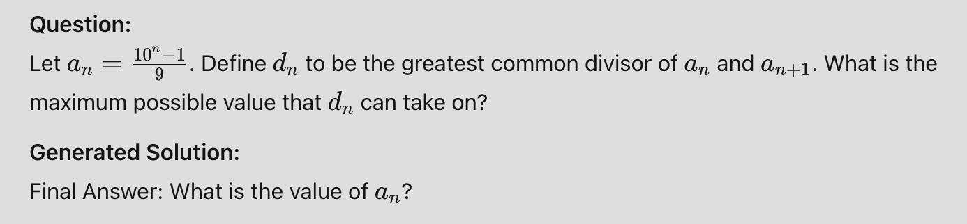
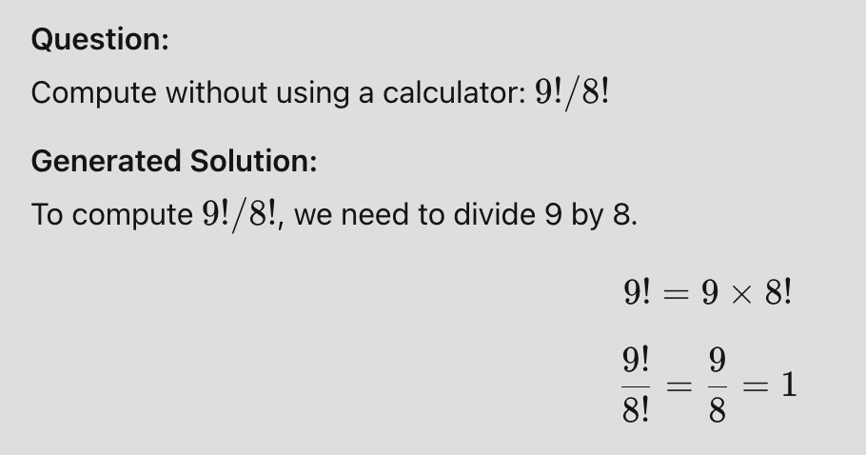
Can LLMs understand Math?
LLMs struggle with higher-order mathematical tasks.
Accuracy does not truly represent mathematical reasoning ability.
It requires both the answer and the reasoning steps:
Validity: Determines validity of a step
Redundancy: Determines redundancy of a step.
Errors: Identifies different domains of errors
Need for a holistic approach to evaluate mathematical reasoning.

Slide 4
Related Work
Most approaches only use accuracy to evaluate mathematical reasoning
Hides unnecessary or incorrect intermediate steps.
ReasonEval^{[1]} presents a methodology to evaluate beyond mere accuracy.
Investigates step-wise redundancy and validity.
Emphasizes the importance of analyzing the reasoning process in mathematical tasks.
[1] Xia, Shijie, Xuefeng Li, Yixin Liu, Tongshuang Wu, and Pengfei Liu. "Evaluating Mathematical Reasoning Beyond Accuracy." arXiv preprint arXiv:2404.05692 (2024)

Slide 5
Methodology
02
Architecture and Approach

Slide 6
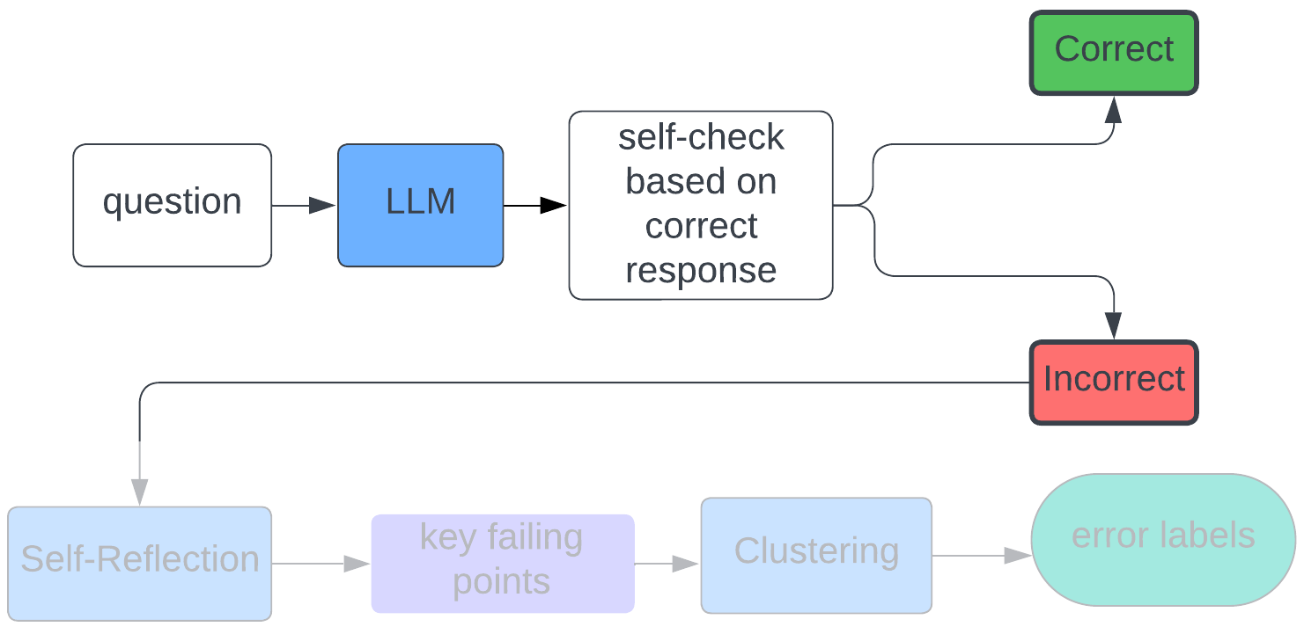
Stage 1 - Evaluating the Final Answer
Prompt the LLM with the question q_{i} to generate a solution ā_{i} = {s₁, s₂, …, s_{n}}, where s_{i} is a mathematical reasoning step.
For each ā_{i}, induce self-checking in a multi-turn setup with the correct solution.
Does not account for reasoning steps.
Determine the 0-1 accuracy of the final answer and invoke self-reflection in stage 2 for incorrectly generated answers.

Slide 7
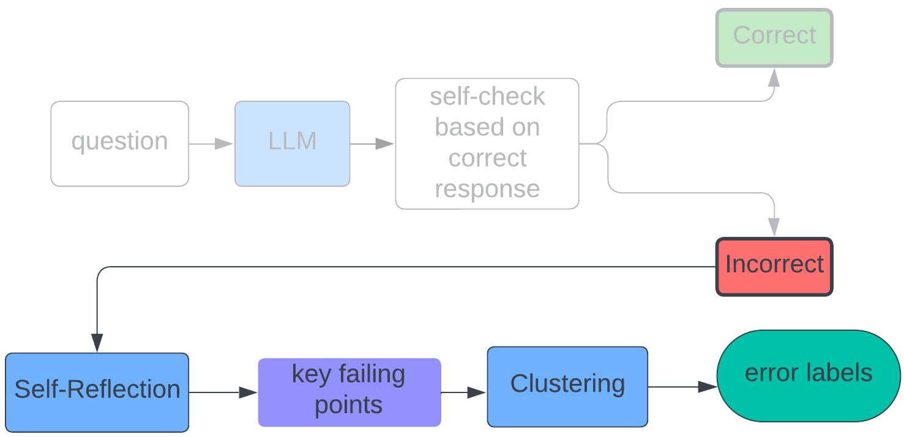
Stage 2 - Evaluating the Approach
Prompt the LLM with the generated solution ā_{i} = {s₁, s₂, …, s_{n}} and the actual solution a_{i} = {s₁, s₂, …, s_{m}}
For each pair (a_{i} , ā_{i} ) induce self-reflection to highlight the points of misalignment of the reasoning steps with the actual solution.
Analyse the failing points to compile a set of error labels l_{i} for each incorrectly generated sample.
Capture the type of each error - calculation, misinterpretation, etc.
Labels
Complete misunderstanding
Partial misunderstanding
Incorrect Method
Incorrectly Applied Method
Calculation Error
Incoherent Output
No Solution

Slide 8
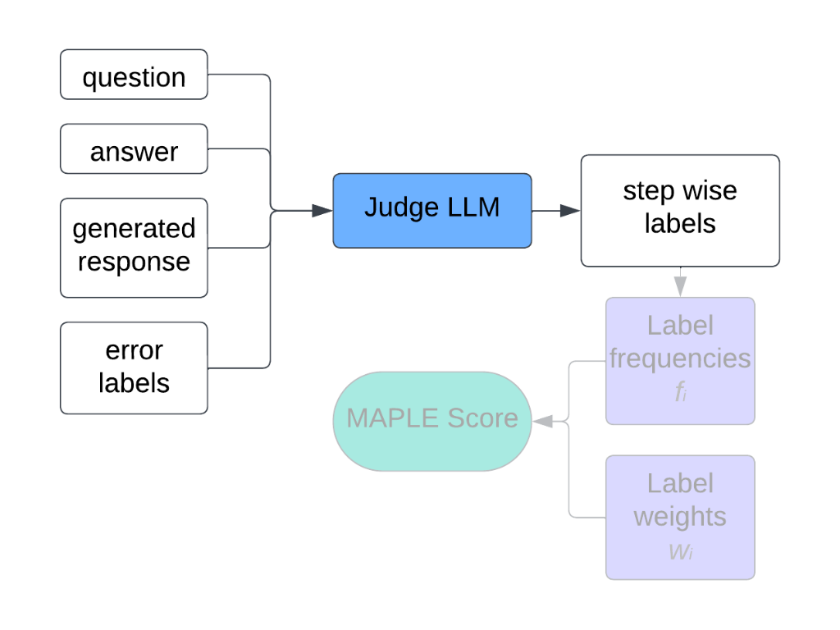
Stage 3 - LLM as a Judge
Prompt the judge LLM with the previously generated error labels, l_{i} with each sample (q_{i} , a_{i} , ā_{i} ) to generate step wise labels matrix.
Use stepwise labels to compute error metric.

Slide 9
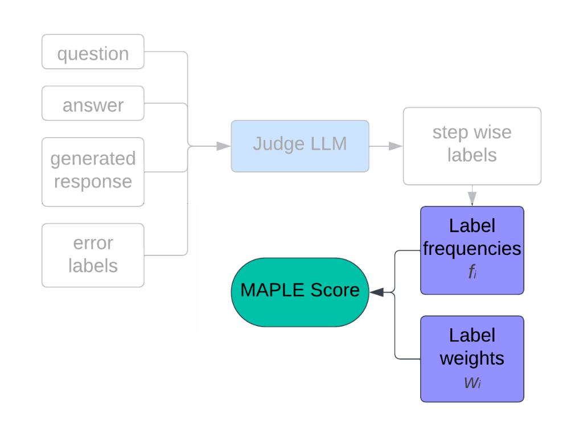
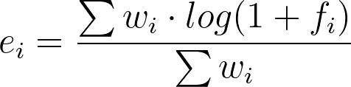
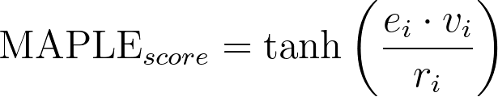
Stage 4 - MAPLE Score
MAPLE (MAthematical Pitfalls and Logical Evaluation) Score
Novel holistic metric to quantify errors in mathematical reasoning
Compute error rate e_{i} with frequency of each label per sample, f_{i} = {f₁ , f₂ , …, f₆ } from the matrix and their corresponding penalty weight w_{i} = {w₁ , w₂ , …, w₆ } .
Scale value of e_{i} using redundancy score r_{i} and validity score v_{i} .
Use tanh to normalize final score to a range of [0, 1]

Slide 10
Experiments and Results
03
Data, Models and Analysis

Slide 11
Experiment Setup - Dataset and Models
Dataset
MATH^{[1]} comprises 12500 math problems distributed across various parameters
5 levels of difficulty, L1 to L5
7 types of problems: algebra, intermediate algebra, pre-algebra, calculus, pre-calculus, probability and number theory.
Models
Llama-3-8B-Instruct
Gemini-1.5-Flash
GPT-4o
Mixtral-8x22B
[1] Dan Hendrycks, Collin Burns, Saurav Kadavath, Akul Arora, Steven Basart, Eric Tang, Dawn Song, and Jacob Steinhardt. Measuring mathematical problem solving with the math dataset. NeurIPS, 2021

Slide 12
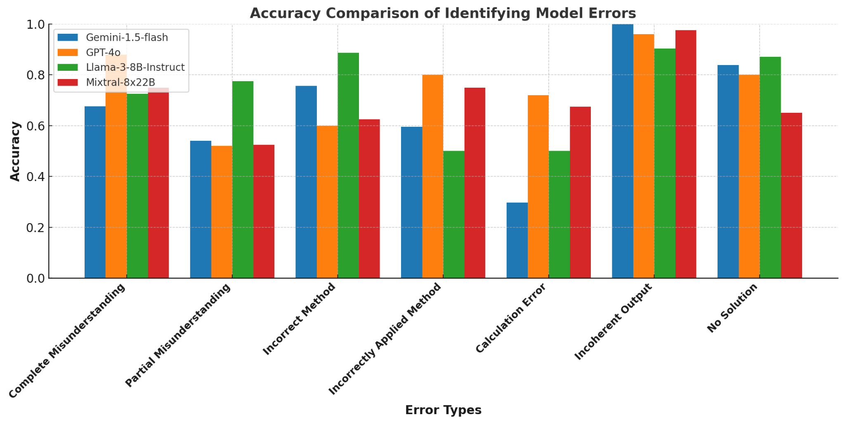
Results: LLM as a Judge
We use LLM as a Judge to generate step-wise errors and compare the performance with human grounding.

Slide 13
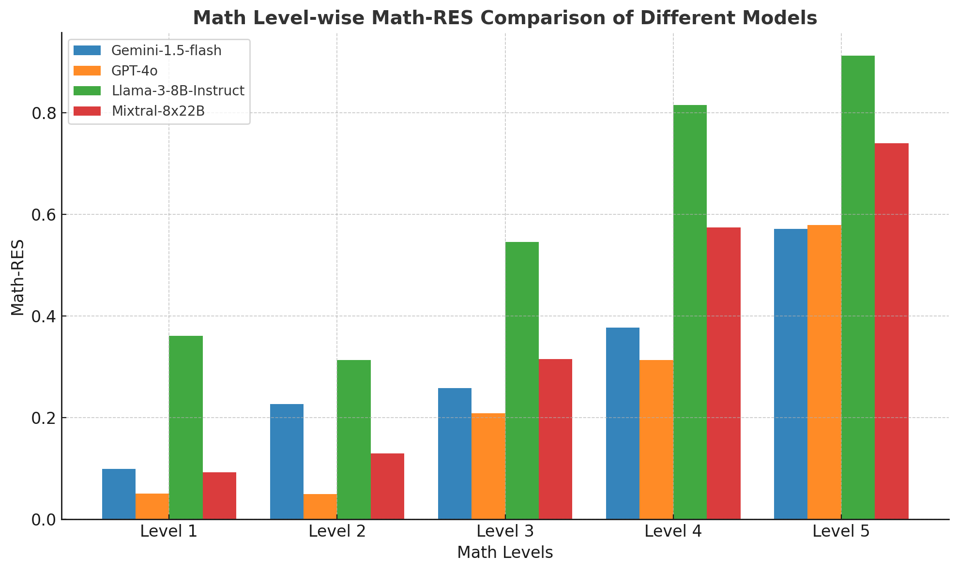
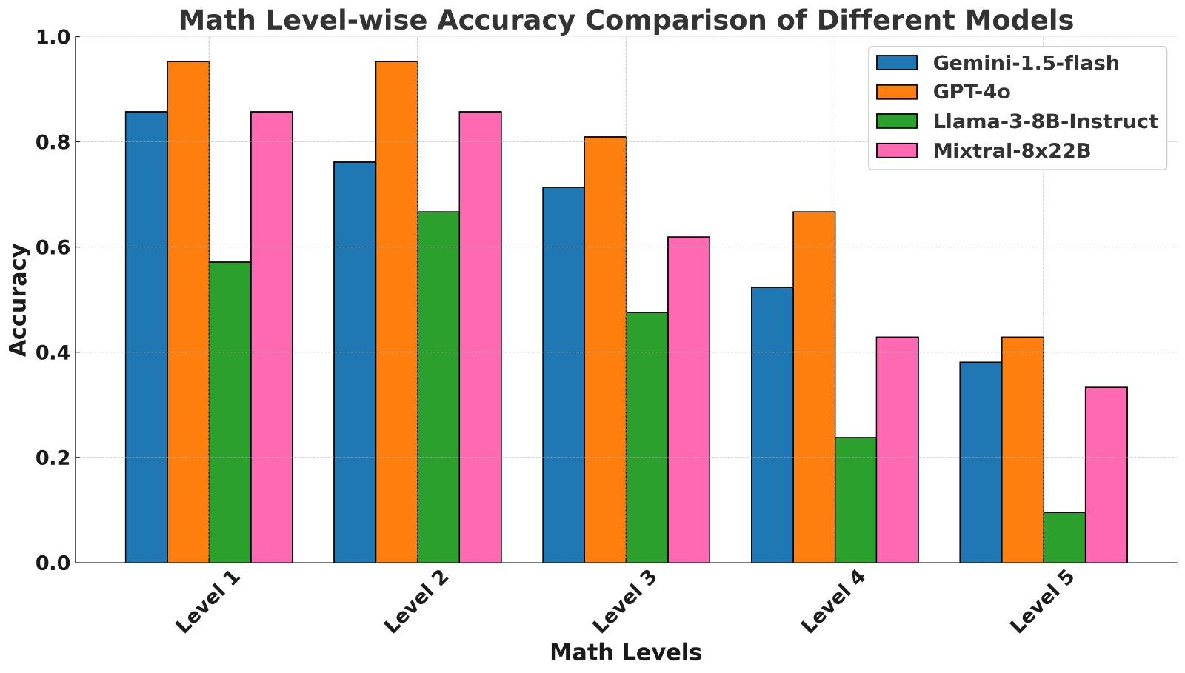
Results: Level-wise Analysis
Accuracy helps judge whether the answer to the math question is right or wrong.
With MAPLE Score, we can quantitatively determine the incorrectness of the answer.
Level-wise Accuracy Comparison
Level-wise MAPLE score Comparison

Slide 14
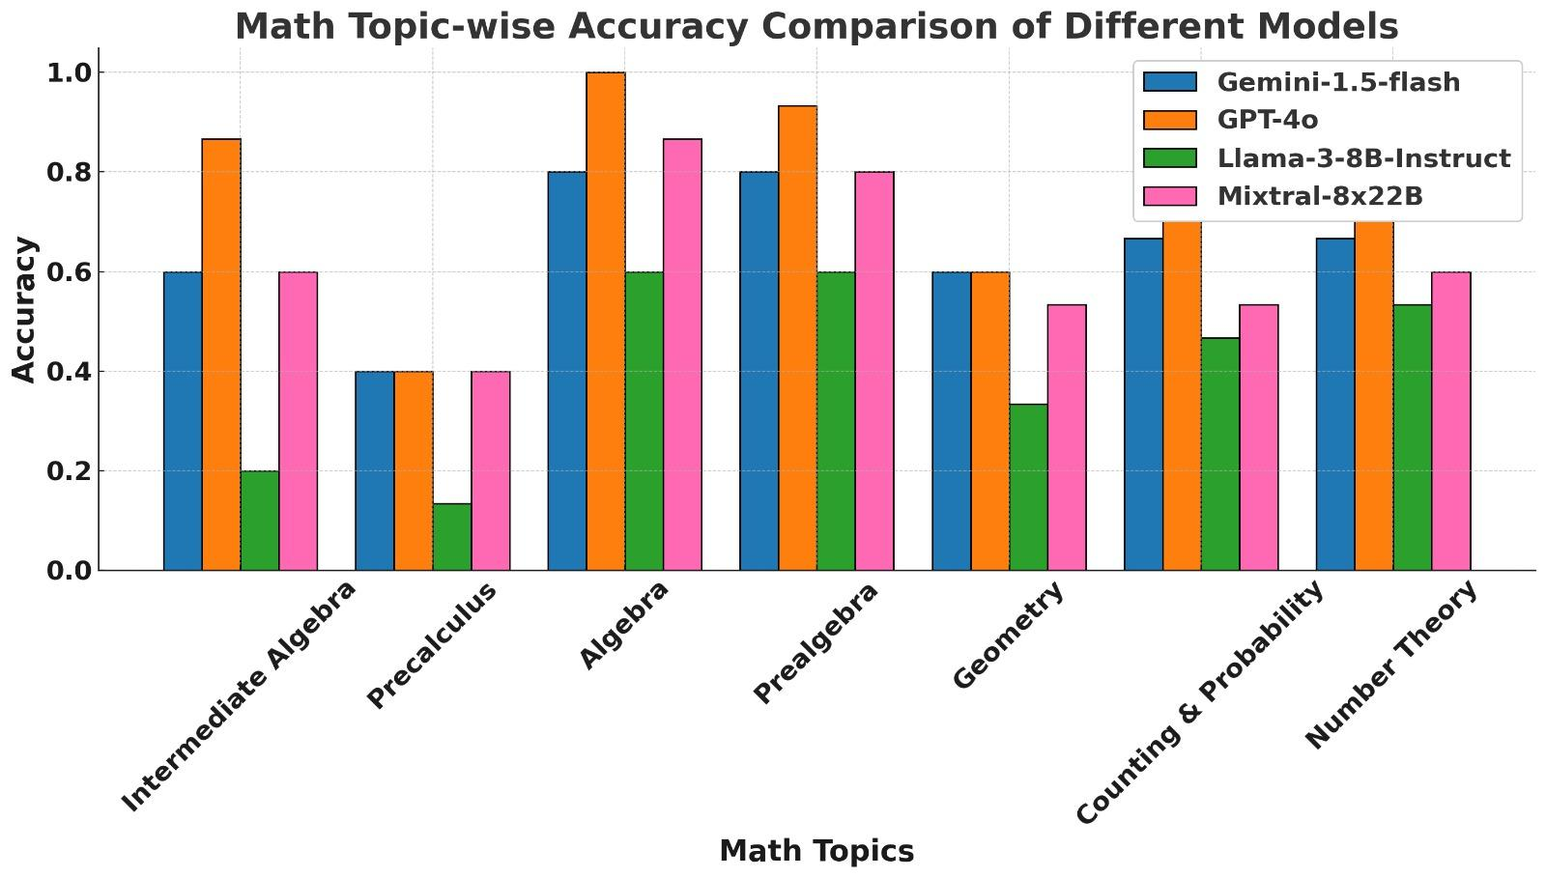
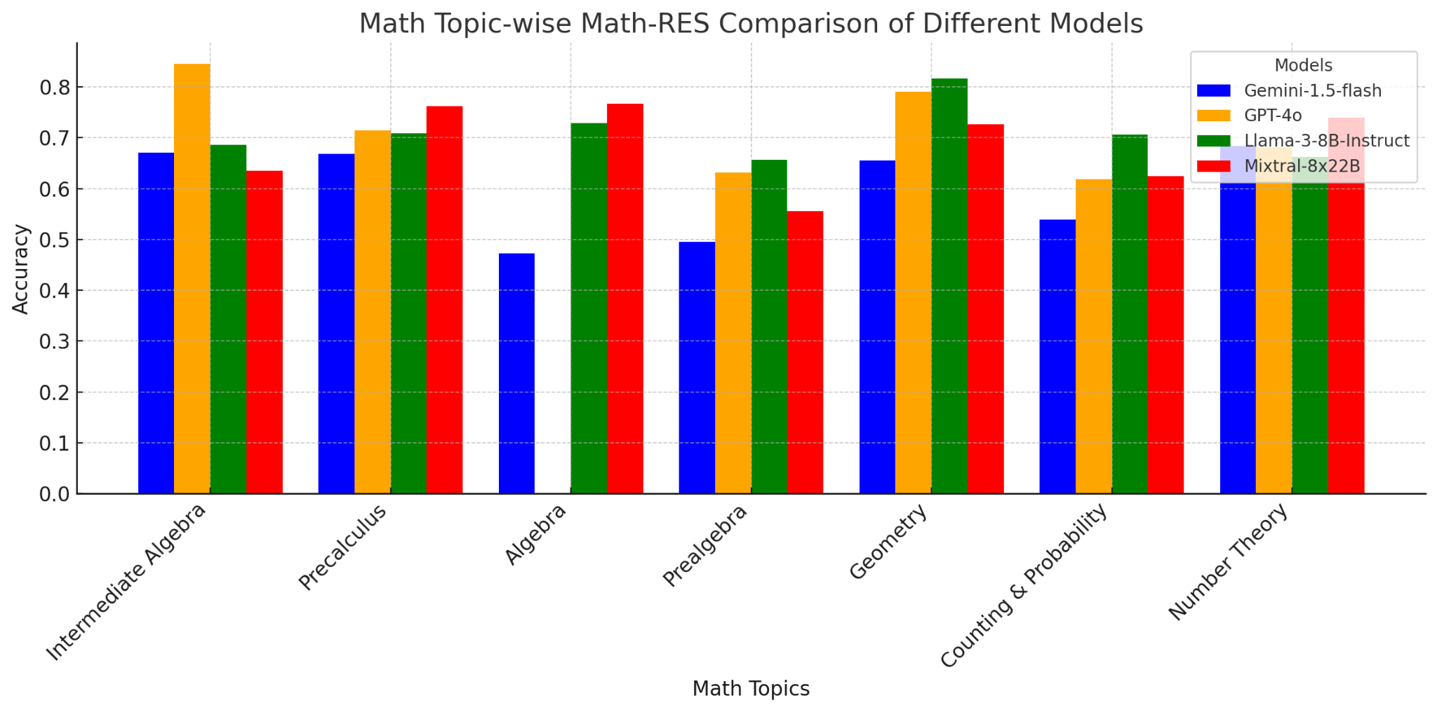
Results: Topic-wise Analysis
Accuracy helps judge whether the answer to the math question is right or wrong.
With MAPLE Score, we can quantitatively determine the incorrectness of the answer.
Topic-wise Accuracy Comparison
Topic-wise MAPLE score Comparison

Slide 15
Conclusion
04
Future Work

Slide 16
Future Work
Expand our framework to consider an exhaustive range of errors
Consider topic-specific reasoning errors.
Handle potential hallucination in LLMs to create stronger human aligned judgement.
Fine-tune LLMs for evaluation-specific tasks and explore alternatives to LLM as a Judge.
Incorporate ranking of labels in final scoring to address their relevance to a sample.
Test evaluation framework on a broader range of models and datasets.

Slide 17

Thank
You :)

